Slide 1

DroneMotion
fly with the force
Notes:
Drones have gotten much more popular, both for personal and commercial uses
But they are hard to fly, people dont want to learn
Other solutions have been presented, hand gestures, but use sensors
Therefore we present…

Slide 2
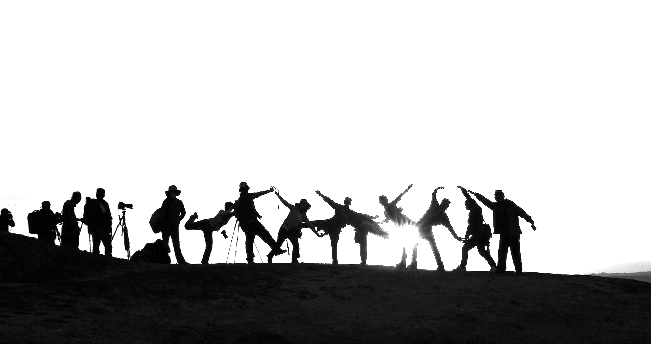
Project Focus:
Bridging AI with humankind to revisit childhood fantasies

Slide 3
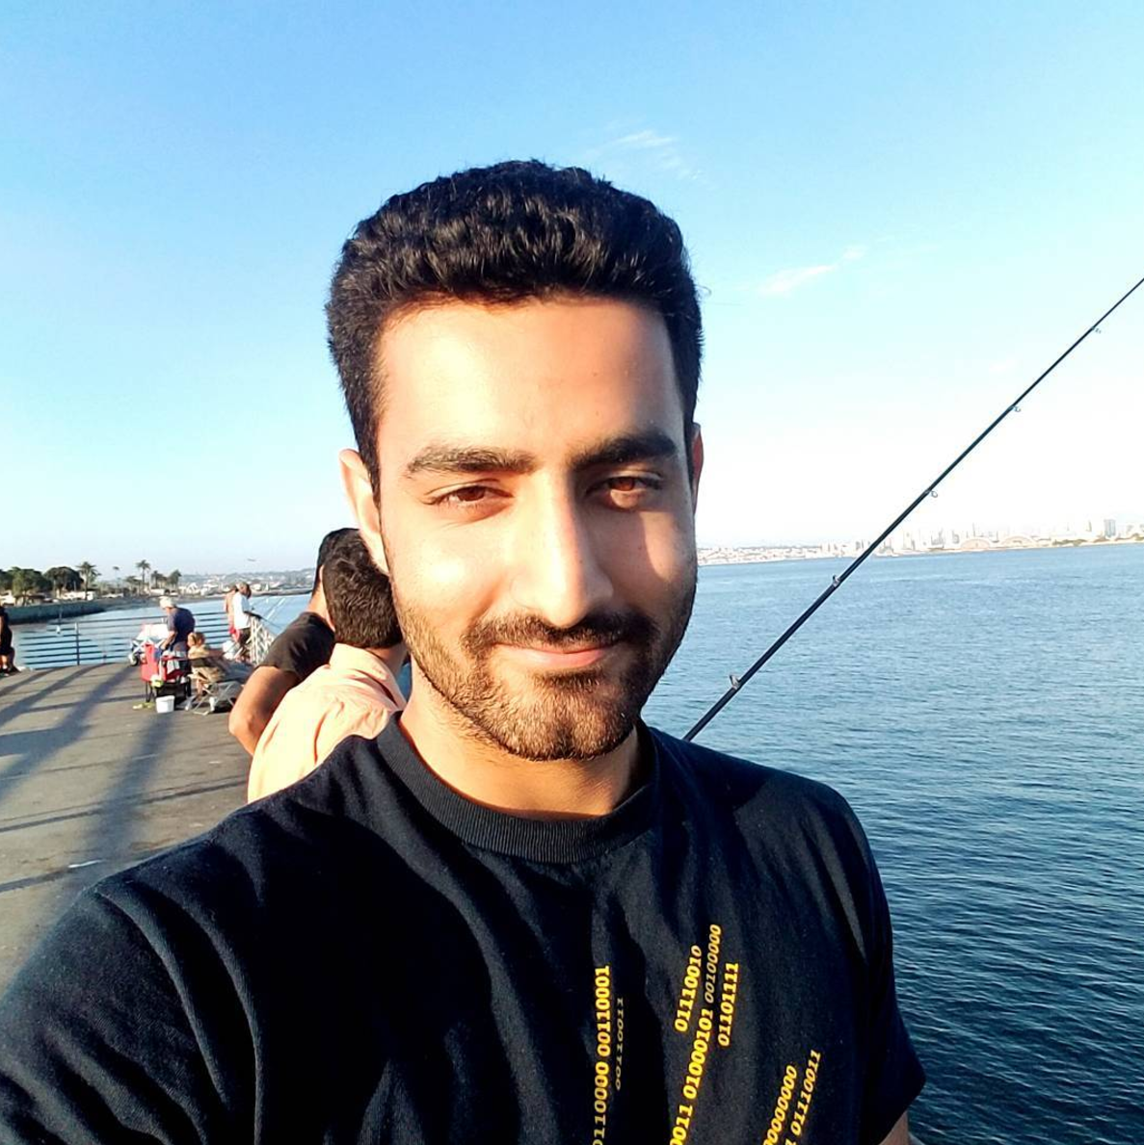
Looking back...

Slide 4
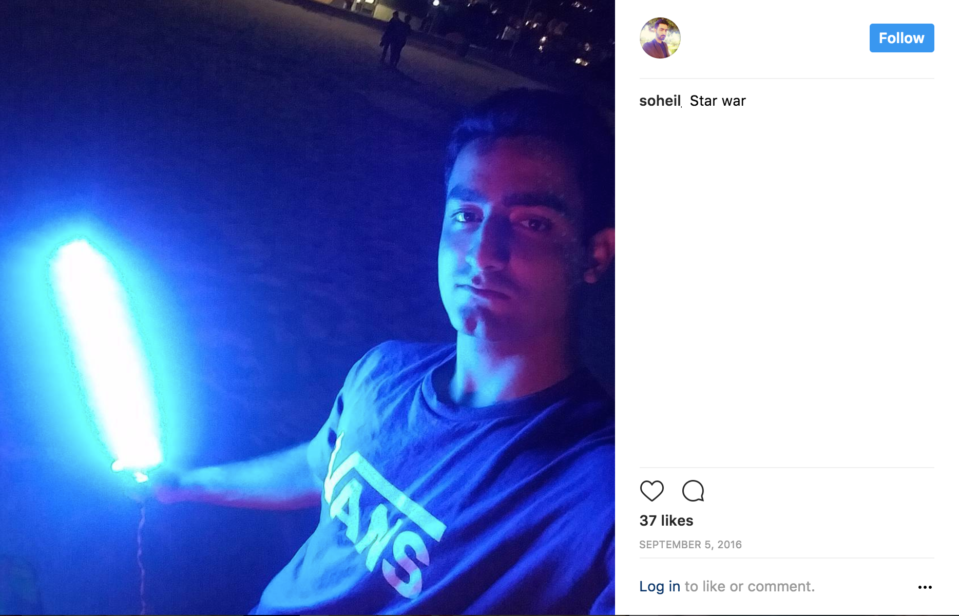
covfefe
Soheil’s Dreams

Slide 5
How Does it Work?
Hand Gesture
Detection
PS-Drone Flight
Hand Gesture Controlled Flight

Slide 6
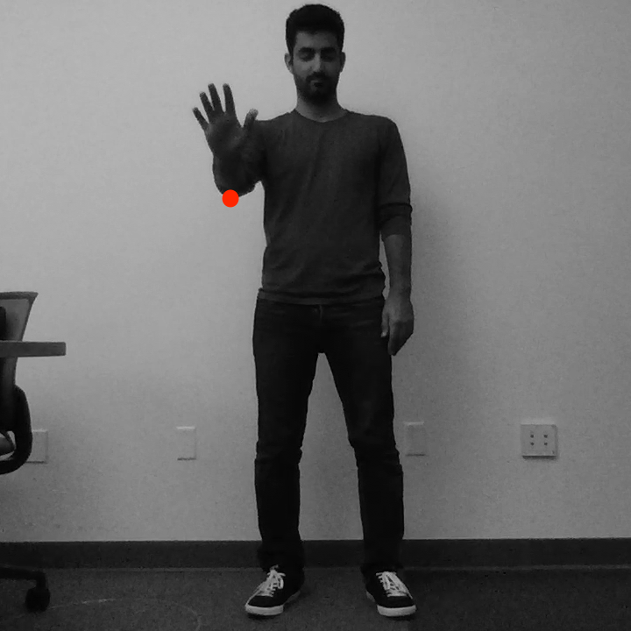
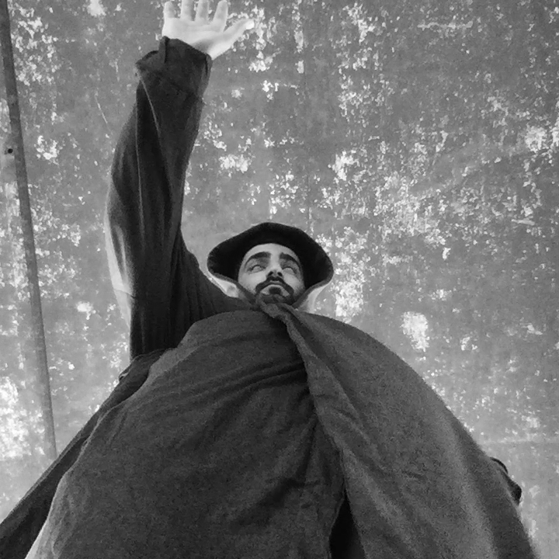
Milestones
Weeks 1 - 5
Hand gesture detection
Weeks | 1 | 2 | 3 | 4 | 5 | 6 | 7 | 8 | 9 | 10
Notes:
First, most important and difficult milestone
We wanted to detect 8 basic motions for the drone
At first we placed camera in front, good results, but not perfecto

Slide 7
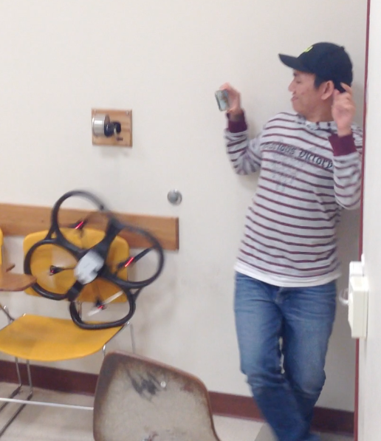
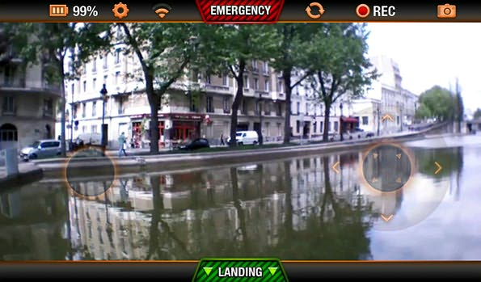
Milestones
Week 6
Piloting Drone
Weeks | 1 | 2 | 3 | 4 | 5 | 6 | 7 | 8 | 9 | 10

Slide 8
Milestones
Deep Learning
Pytorch
Resnet
Discrete Bayes
Noise reduction
Frame Classification
PS-Drone
Move Optimization
Flight
Weeks 7 - 8
Weeks 9 - 10
Connecting the Systems
Optimization
Weeks | 1 | 2 | 3 | 4 | 5 | 6 | 7 | 8 | 9 | 10

Slide 9
Future work
Notes:
Phone?
VIdeo from camera to do something? (nah)
Soheil will implement ROS

Slide 10
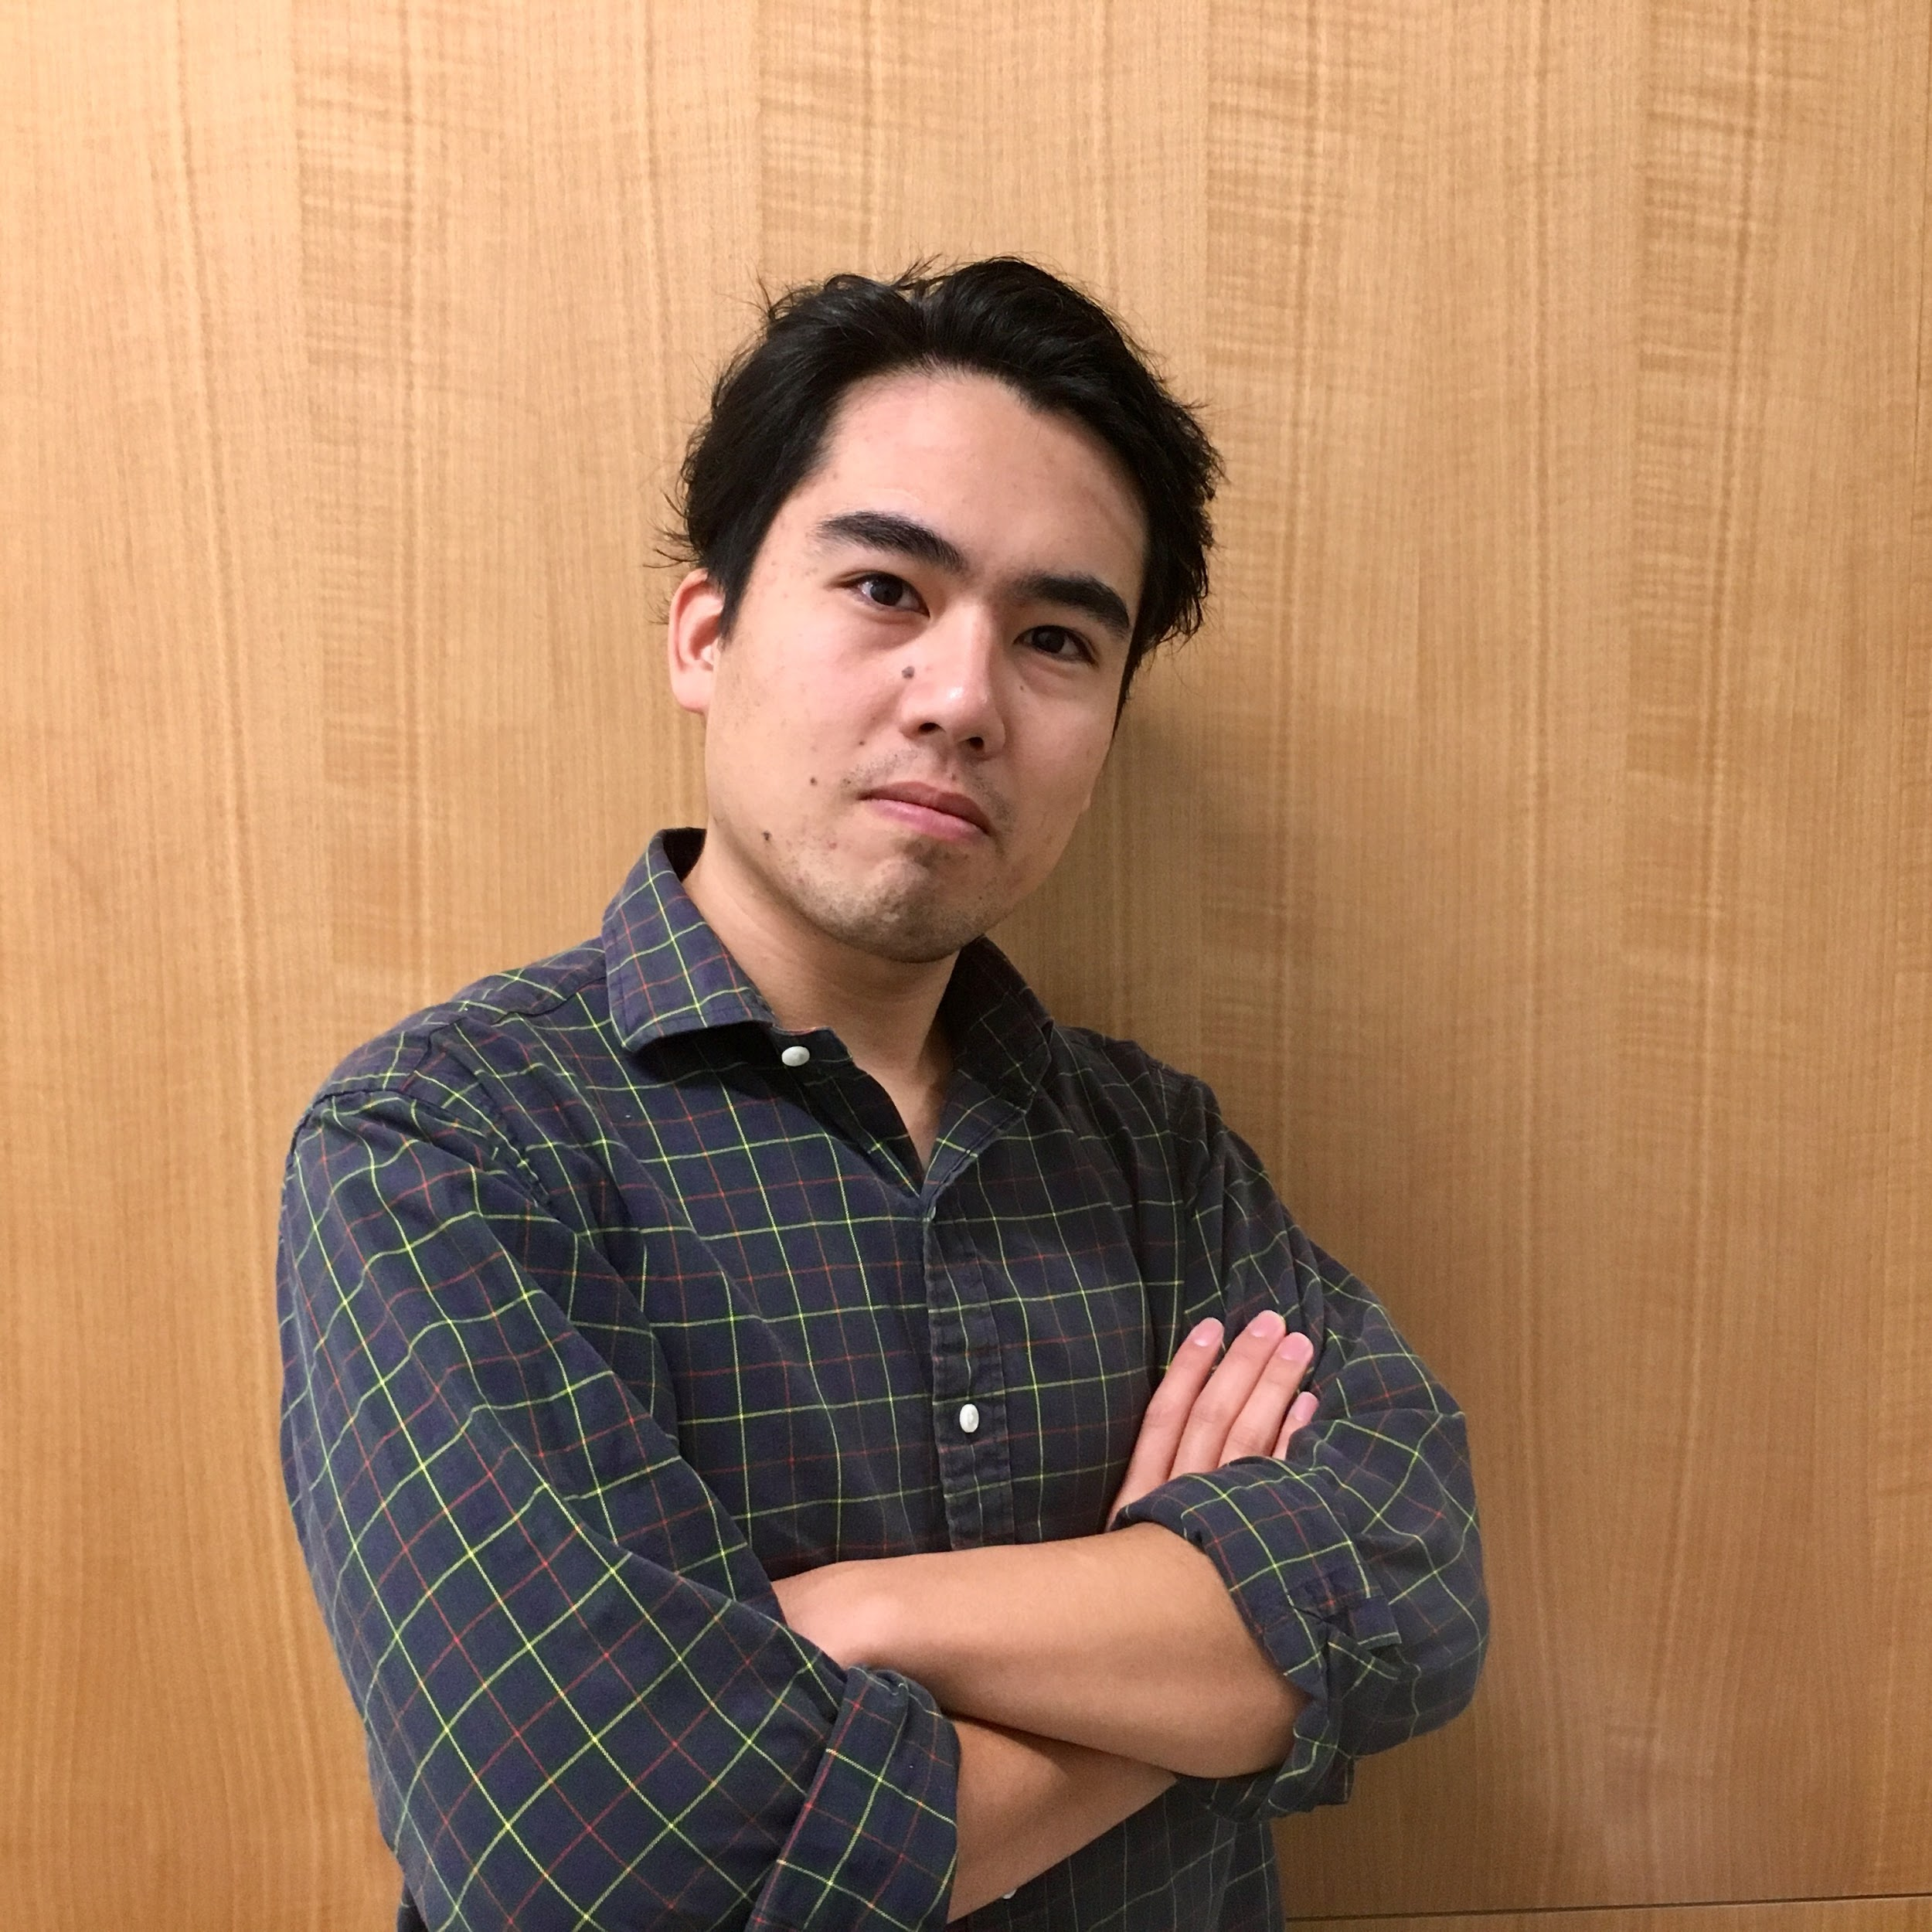
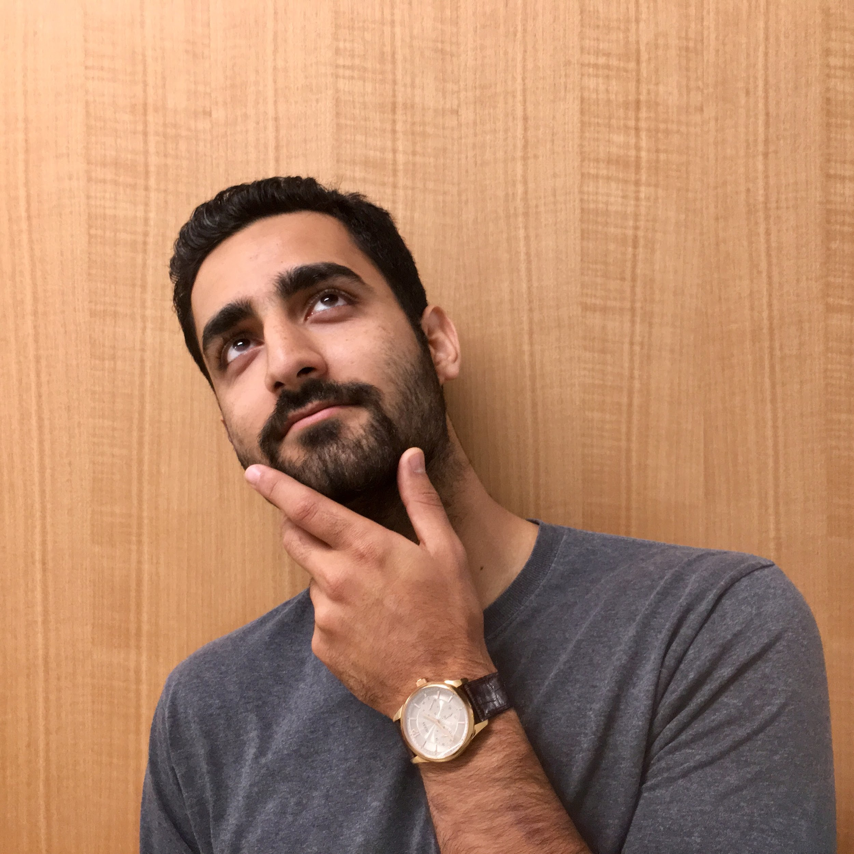
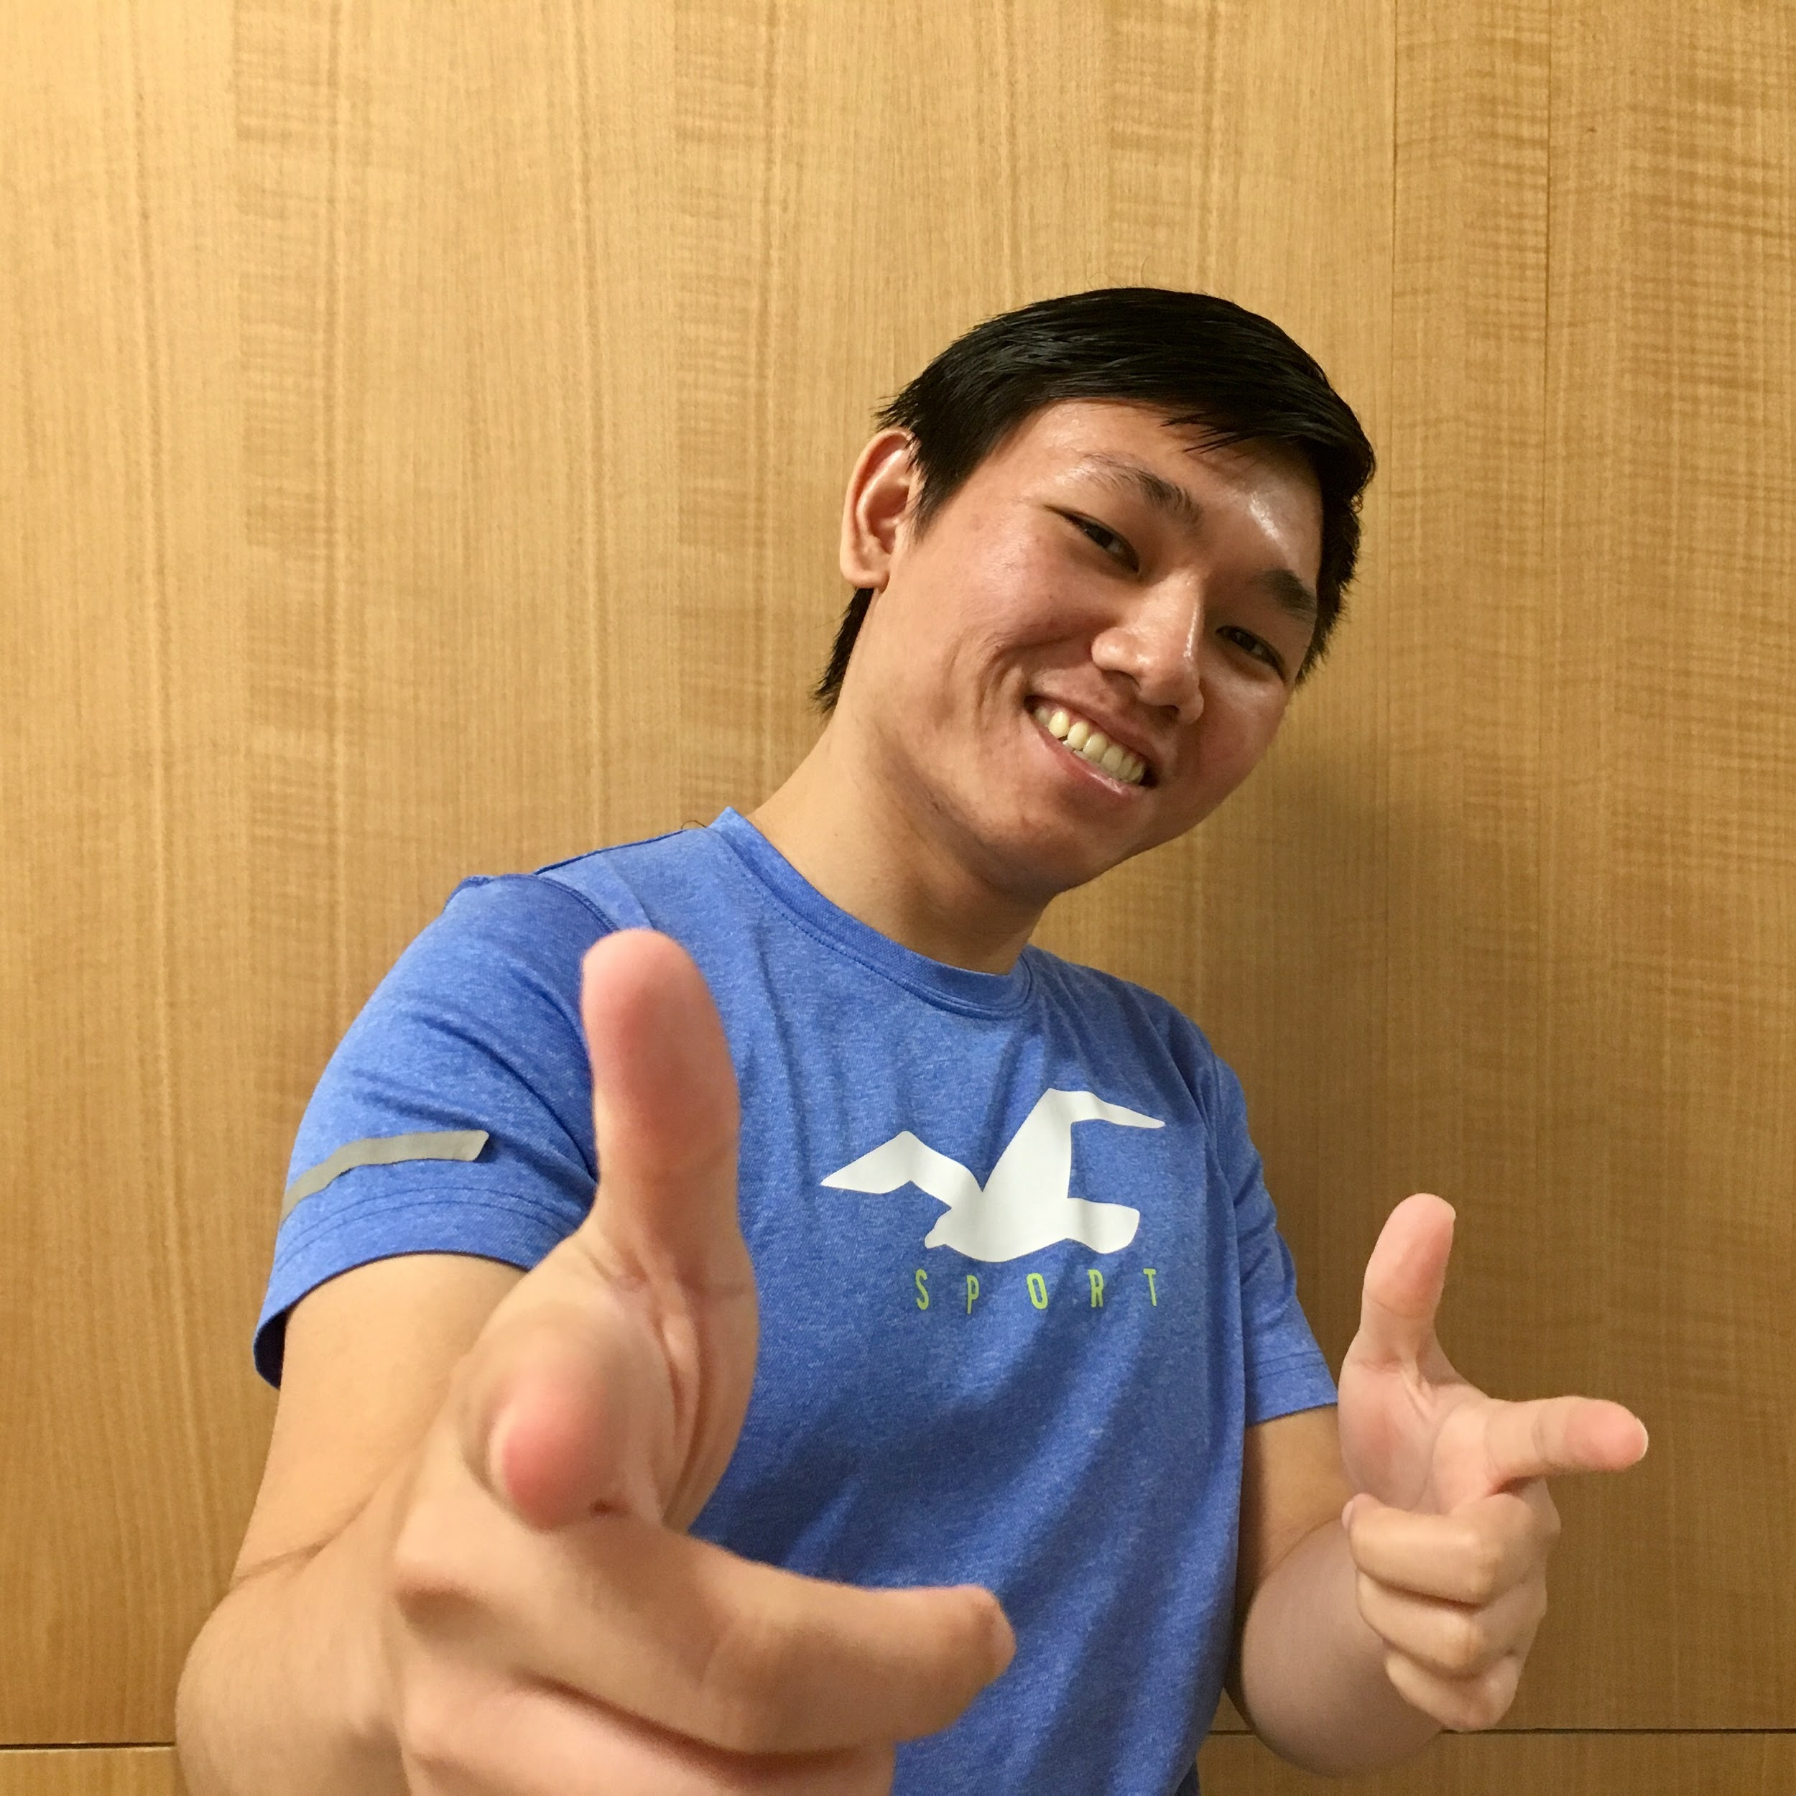
Answer the question, “Why are we the ones to solve the problem we identified?”
Hakan Erol
Joji Asako
Soheil Karimi
Trivi Tran
“Are we done?”
“Soheil, why aren’t you doing anything?”
“Looking back…”
“Can you repeat your question?”

